Slide 1
3.Modeling and Evaluation
Dr.K DeviPriya
Associate Professor
CSE,LBRCE

Slide 2
Machine Learning Introduction
Data Input
Abstraction
Generalization

Slide 3
3.2 Selecting a Model
Problem New City police wants to take a proactive action to eliminate all criminal activities in region.
Want to find the pattern of criminal activities in the past
Find the criminal activities per month based on any other parameters like average income of local population, weapon sales, inflow of immigrants etc.,

Slide 4
The goal or target
The goal or target is to develop a model to infer how the criminal incidents change based on the potential influencing factors mentioned above.
In ml paradigm, the potential causes of disturbance eg: avg of income of the local population, weapon sales, the inflow of immigrants etc., are input variables, predictors, attributes, features, independent variables or simply variables.

Slide 5
The number of criminal incidents is an output variable or response variable or dependent variable.
Input variables can be denoted by X, while individual input variables are represented as X1,X2,X3,….Xn and output variable by Y.
The relationship between X and Y is represented as the general form : Y=f(X)+e, where ‘f’ is the target function and ‘e’ is the random error term

Slide 6
functions
Target function=Y=f(x)+e
Cost function/error function-helps to measure the bad performance of the model-function defined on entire data set.
Loss function-similar to cost function but function defined on data point
Objective function
--This function goal is to find the optimal solution

Slide 7
functions
Objective function
--This function goal is to find the optimal solution.

Slide 8
Types of ML
Supervised
a. Classification
b. Regression
Unsupervised
a. Clustering
b. Association analysis
Reinforcement

Slide 9
3.2.1 predictive Model
Predicting win/loss in a cricket match
Predicting whether a transaction is fraud
Predicting whether a customer may move to another product.
The models which are used for prediction target of features of categorical values are known as classification models.
The target features is known as class and the categories to which classes are divided into levels.
KNN, Naïve Bayes, and Decision trees.

Slide 10
3.2.1 Points to Ponder
Categrorical values can be converted into numerical and vice versa
Eg:stock price growth prediction can be represented by categeorical values
0% to 5%----low
6 to 10-moderate
11-15 high
16-20 very high
>20 booming

Slide 11
3.2.1 Points to Ponder
Categorical values can be converted into numerical and vice versa.
Eg:categorical values converted into numerical values.
In tumor malignancy detection problem ,replace benign as 0 and malignant as 1

Slide 12
Multiple factors to be considered while selecting model
While selecting the model for prediction the size of the training data is very important
If the training data set size is too small then low variance model like naïve bayesian are supposed to perform better because model over fitting needs to avoid in this situvation
For under fitting-More data set logistic regression models

Slide 13
Descriptive model
Grouping of data
Clustering

Slide 14
Evaluating Performance of a model
Supervised Learning classification
The responsibility of the classification model is to assign class label to the target feature based on the value of the predictor features.
For example, in the problem of predicting the win/loss in a cricket match, the classifier will assign a class value win/loss to target feature
based on the values of other features like whether team won the toss, number of spinners in the team, number of wins the team had tournament ,etc.

Slide 15
Evaluating Performance of a model
Supervised Learning classification
The responsibility of the classification model is to assign class label to the target feature based on the value of the predictor features.
For example, in the problem of predicting the win/loss in a cricket match, the classifier will assign a class value win/loss to target feature
based on the values of other features like whether team won the toss, number of spinners in the team, number of wins the team had tournament ,etc.

Slide 16
Evaluating Performance of a model
To evaluate the performance model ,the number of correct classifications or predictions made by the model has to be recorded.
A classification is said to be correct if, say for the example in the given problem ,it has been predicted by the model that team will win and it has actually won.

Slide 17
Four possibilities with regards to the cricket match win/loss prediction
The model predicted win and team won
The model predicted win and team lost.
The model predicted loss and team won.
The model predicted loss and team lost.

Slide 18
Cricket Match Won Prediction
Consider the cricket match between two teams A,B and predict whether team-A will be win or not
Based on the prediction find the result belongs to which type ?
True positive
False Positive
True Negative
False NEGATIVE
‘

Slide 19
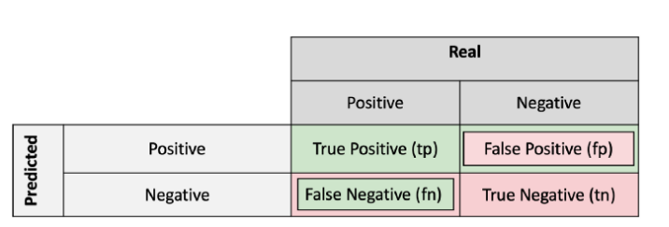
Confusion Matrix

Slide 20
Confusion Matrix
Confusion Matrix
 | Actual Win | Actual Loss
Predicted Win | 85 | 4
Predicted Loss | 2 | 9

Slide 21
Model accuracy=(TP+TN)/(TP+FP+FN+TN)
Error Rate=(FP+FN)/(TP+FP+FN+TN)

Slide 22
TP=85,FP=4,FN=2,TN=9
Model Accuracy= =(TP+TN)/(TP+FP+FN+TN)
Model error= (FP+FN)/(TP+FP+FN+TN)
=1-accuracy

Slide 23
Accuracy: the proportion of the total number of predictions that were correct.
Error: the proportion of the total number of predictions that were correct.

Slide 24
Sensitivity or Recall: the proportion of actual positive cases which are correctly identified.
Specificity: the proportion of actual negative cases which are correctly identified.
=TN/TN+FP
FP=Model predicted as positive but in reality(actual) the target is Negative

Slide 25
Positive Predictive Value or Precision: the proportion of positive cases that were correctly identified.
F-Measure-Measure of model performance which combines both precision and recall
F-Measure=2*Precision*recall/(Precision+recall)

Slide 26
Sensitivity or True Positive Rate
Sensitivity is a measure of how well a machine learning model can detect positive instances.
It is also known as the true positive rate (TPR) or recall.
Sensitivity is used to evaluate model performance because it allows us to see how many positive instances the model was able to correctly identify
Sensitivity=(TP)/(TP+FN)

Slide 27
Sensitivity
Sensitivity is used to evaluate model performance because it allows us to see how many positive instances the model was able to correctly identify
Sensitivity=(TP)/(TP+FN)
Or
True Positives/Total No of positives in Actual
A high sensitivity means that the model is correctly identifying most of the positive results, while a low sensitivity means that the model is missing a lot of positive results.

Slide 28
Specificity or True Negative Rate
Specificity measures the proportion of true negatives that are correctly identified by the model.
This implies that there will be another proportion of actual negative which got predicted as positive and could be termed as false positives.
This proportion could also be called a True Negative Rate (TNR).
The sum of specificity (true negative rate) and false positive rate would always be 1.

Slide 29
specificity
High specificity means that the model is correctly identifying most of the negative results, while a low specificity means that the model is mislabeling a lot of negative results as positive.
Specificity=(TN)/(TN+FP)
Or
True Negatives/(Total No of Negative classes(Actual))

Slide 30
Precision
Precision — Out of all the examples that predicted as positive, how many are really positive?
Precision=TP/(TP+FP)

Slide 31
Recalls
Recall — Out of all the positive examples, how many are predicted as positive? Recall=TP/(TP+FN)

Slide 32
Kappa Score
Kappa can range from 0 to 1. A value of 0 means that there is no agreement between the raters (real-world observer vs classification model), and a value of 1 means that there is perfect agreement between the raters. In most cases, anything over 0.7 is considered to be very good agreement.

Slide 33
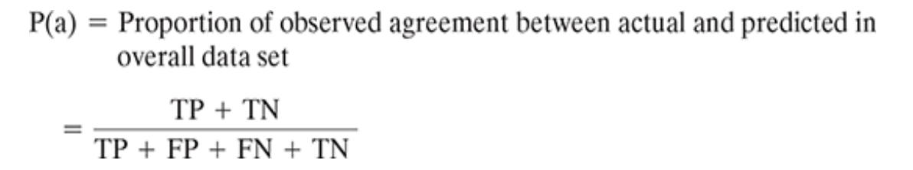
Kappa Score
Kappa Score

Slide 34
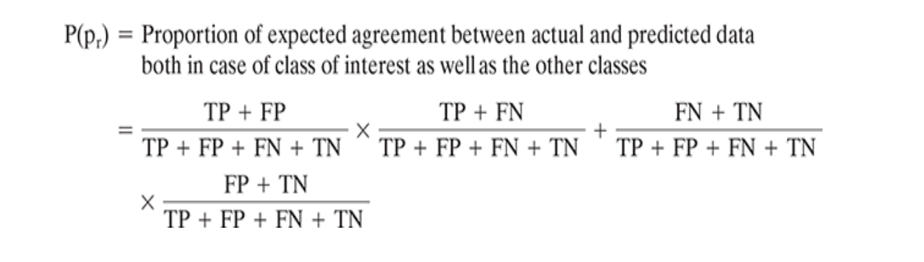
Kappa Score

Slide 35
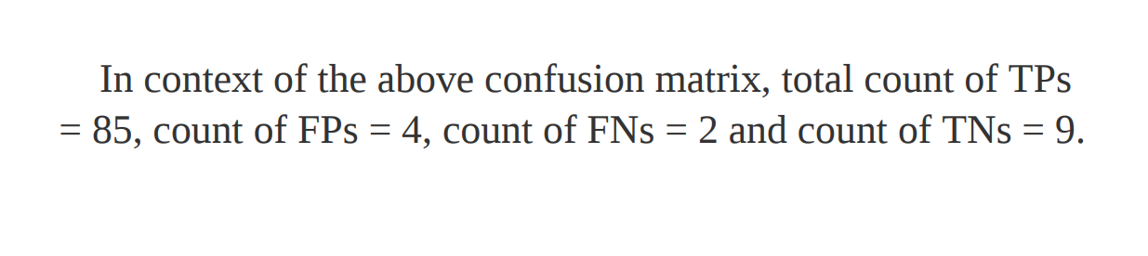
Kappa Score

Slide 36
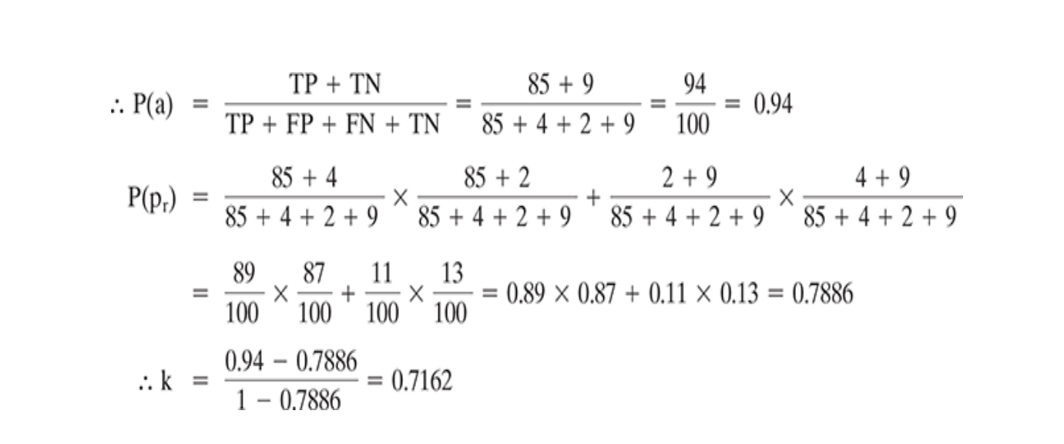
Kappa Score

